Slide 1




Smart Contract Security Audit
TechRate June, 2021

Slide 2
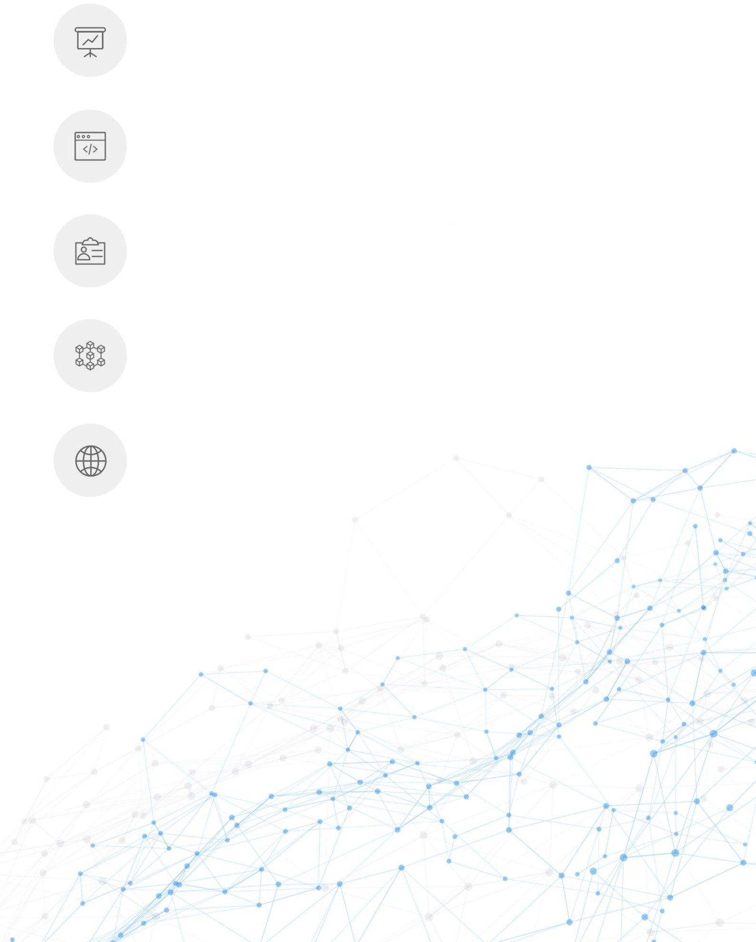
Audit Details
Audited project
Light of tomorrow
Deployer address
TEMfr8XhhVwsPPVkrxMWNEVeA5UNPGD5QD
Client contacts:
Light of tomorrow Token team
Blockchain
Trc Smart Chain
Project website:
tomorrowLight.club

Slide 3

Disclaimer
This is a limited report on our findings based on our analysis, in accordance with good industry practice as at the date of this report, in relation to cybersecurity vulnerabilities and issues in the framework and algorithms based on smart contracts, the details of which are set out in this report. In order to get a full view of our analysis, it is crucial for you to read the full report. While we have done our best in conducting our analysis and producing this report, it is important to note that you should not rely on this report and cannot claim against us on the basis of what it says or doesn’t say, or how we produced it, and it is important for you to conduct your own independent investigations before making any decisions. We go into more detail on this in the below disclaimer below – please make sure to read it in full.
DISCLAIMER: By reading this report or any part of it, you agree to the terms of this disclaimer. If you do not agree to the terms, then please immediately cease reading this report, and delete and destroy any and all copies of this report downloaded and/or printed by you. This report is provided for information purposes only and on a non-reliance basis, and does not constitute investment advice. No one shall have any right to rely on the report or its contents, and TechRate and its affiliates (including holding companies, shareholders, subsidiaries, employees, directors, officers and other representatives) (TechRate) owe no duty of care towards you or any other person, nor does TechRate make any warranty or representation to any person on the accuracy or completeness of the report. The report is provided "as is", without any conditions, warranties or other terms of any kind except as set out in this disclaimer, and TechRate hereby excludes all representations, warranties, conditions and other terms (including, without limitation, the warranties implied by law of satisfactory quality, fitness for purpose and the use of reasonable care and skill) which, but for this clause, might have effect in relation to the report. Except and only to the extent that it is prohibited by law, TechRate hereby excludes all liability and responsibility, and neither you nor any other person shall have any claim against TechRate, for any amount or kind of loss or damage that may result to you or any other person (including without limitation, any direct, indirect, special, punitive, consequential or pure economic loss or damages, or any loss of income, profits, goodwill, data, contracts, use of money, or business interruption, and whether in delict, tort (including without limitation negligence), contract, breach of statutory duty, misrepresentation (whether innocent or negligent) or otherwise under any claim of any nature whatsoever in any jurisdiction) in any way arising from or connected with this report and the use, inability to use or the results of use of this report, and any reliance on this report.
The analysis of the security is purely based on the smart contracts alone. No applications or operations were reviewed for security. No product code has been reviewed.

Slide 4

Background
Techrate is entrusted by tomorrow's light token to audit the wavefield intelligent contract:
https://tronscan.io/#/contract/TEMfr8XhhVwsPPVkrxMWNEVeA5UNPGD5QD/code
The purpose of the audit was to achieve the following:
Ensure that the smart contract functions as intended.
Identify potential security issues with the smart contract.
The information in this report should be used to understand the risk exposure of the smart contract, and as a guide to improve the security posture of the smart contract by remediating the issues that were identified.

Slide 5
Сontracts Details
Token contract details for 09.15.2021
Contract name | lot Token
Contract address | TEMfr8XhhVwsPPVkrxMWNEVeA5UNPGD5QD
Total supply | 168 000 000
Token ticker | Light of tomorrow
Decimals | 10
Token holders | 5
Transactions count | 5
Top 100 holders dominance | 86%
Liquidity fee | 4.5
Tax fee | 5.5
Total fees | 16800000
Uniswap V2 pair
Contract deployer address | TEMfr8XhhVwsPPVkrxMWNEVeA5UNPGD5QD
Contract’s current owner address | TFGEwJasAtmB2FT4Kb96bui7wzZKGBs7aQ

Slide 6
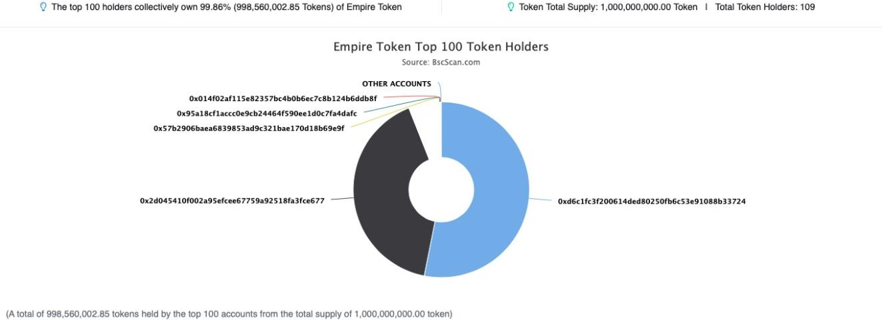
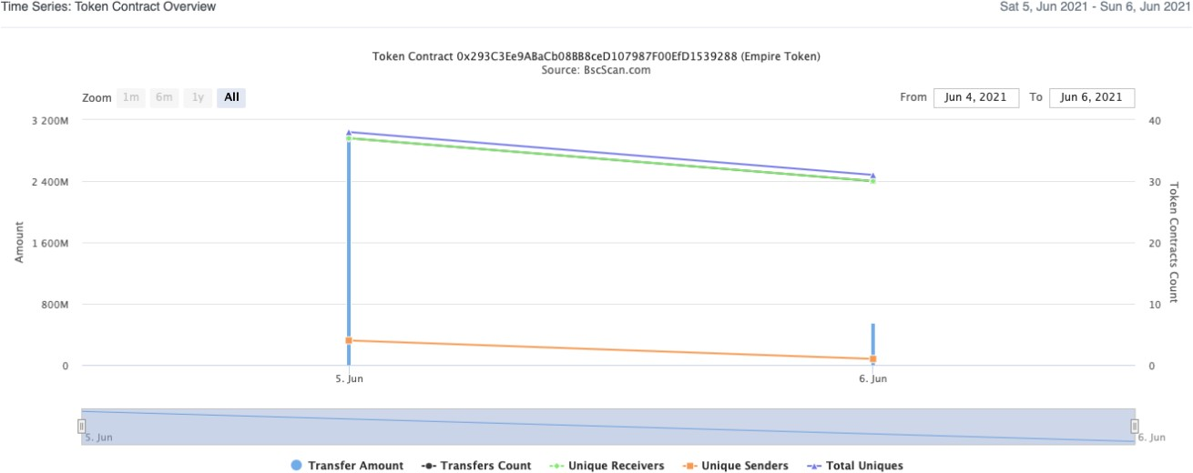
Tomorrow's light token distribution
Tomorrow's light token distribution

Slide 7
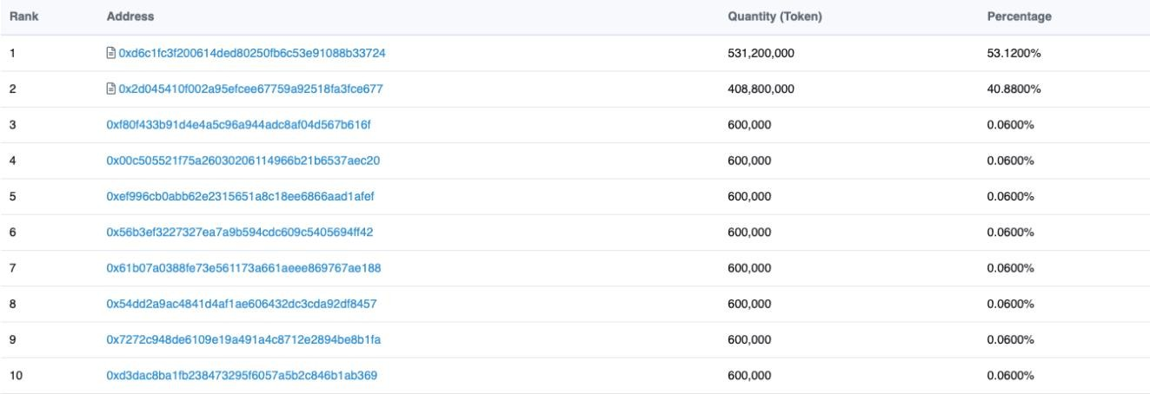
Light of tomorrowToken Top 10 Token Holders

Slide 8
Contract functions details
+ [Int] IERC20
[Ext] totalSupply
[Ext] balanceOf
[Ext] transfer #
[Ext] allowance
[Ext] approve #
[Ext] transferFrom #
+ [Lib] SafeMath
[Int] add
[Int] sub
[Int] sub
[Int] mul
[Int] div
[Int] div
[Int] mod
[Int] mod
+ Context
[Int] _msgSender
[Int] _msgData
+ [Lib] Address
[Int] isContract
[Int] sendValue #
[Int] functionCall #
[Int] functionCall #
[Int] functionCallWithValue #
[Int] functionCallWithValue #
[Prv] _functionCallWithValue #
+ Ownable (Context)
[Int] <Constructor> #
[Pub] owner
[Pub] renounceOwnership #
modifiers: onlyOwner
[Pub] transferOwnership #
modifiers: onlyOwner
[Pub] geUnlockTime
[Pub] lock #
modifiers: onlyOwner
[Pub] unlock #
+ [Int] IUniswapV2Factory
[Ext] feeTo
[Ext] feeToSetter
[Ext] getPair
[Ext] allPairs
[Ext] allPairsLength
[Ext] createPair #
[Ext] setFeeTo #

Slide 9
[Ext] setFeeToSetter #
+ [Int] IUniswapV2Pair
[Ext] name
[Ext] symbol
[Ext] decimals
[Ext] totalSupply
[Ext] balanceOf
[Ext] allowance
[Ext] approve #
[Ext] transfer #
[Ext] transferFrom #
[Ext] DOMAIN_SEPARATOR
[Ext] PERMIT_TYPEHASH
[Ext] nonces
[Ext] permit #
[Ext] MINIMUM_LIQUIDITY
[Ext] factory
[Ext] token0
[Ext] token1
[Ext] getReserves
[Ext] price0CumulativeLast
[Ext] price1CumulativeLast
[Ext] kLast
[Ext] mint #
[Ext] burn #
[Ext] swap #
[Ext] skim #
[Ext] sync #
[Ext] initialize #
+ [Int] IUniswapV2Router01
[Ext] factory
[Ext] WETH
[Ext] addLiquidity #
[Ext] addLiquidityETH ($)
[Ext] removeLiquidity #
[Ext] removeLiquidityETH #
[Ext] removeLiquidityWithPermit #
[Ext] removeLiquidityETHWithPermit #
[Ext] swapExactTokensForTokens #
[Ext] swapTokensForExactTokens #
[Ext] swapExactETHForTokens ($)
[Ext] swapTokensForExactETH #
[Ext] swapExactTokensForETH #
[Ext] swapETHForExactTokens ($)
[Ext] quote
[Ext] getAmountOut
[Ext] getAmountIn
[Ext] getAmountsOut
[Ext] getAmountsIn
+ [Int] IUniswapV2Router02 (IUniswapV2Router01)
[Ext] removeLiquidityETHSupportingFeeOnTransferTokens #
[Ext] removeLiquidityETHWithPermitSupportingFeeOnTransferTokens #

Slide 10
[Ext] swapExactTokensForTokensSupportingFeeOnTransferTokens #
[Ext] swapExactETHForTokensSupportingFeeOnTransferTokens ($)
[Ext] swapExactTokensForETHSupportingFeeOnTransferTokens #
+ Empire (Context, IERC20, Ownable)
[Pub] <Constructor> #
[Pub] setNumTokensToSellForLiquidity #
modifiers: onlyOwner
[Pub] setDevWallet #
modifiers: onlyOwner
[Pub] name
[Pub] symbol
[Pub] decimals
[Pub] totalSupply
[Pub] balanceOf
[Pub] transfer #
[Pub] allowance
[Pub] updateRouter #
modifiers: onlyOwner
[Pub] approve #
[Pub] transferFrom #
[Pub] increaseAllowance #
[Pub] decreaseAllowance #
[Pub] isExcludedFromReward
[Pub] totalFees
[Pub] deliver #
[Pub] setNotReflectionFraction #
modifiers: onlyOwner
[Pub] reflectionFromToken
[Pub] tokenFromReflection
[Pub] excludeFromReward #
modifiers: onlyOwner
[Ext] includeInReward #
modifiers: onlyOwner
[Prv] _transferBothExcluded #
[Pub] excludeFromFee #
modifiers: onlyOwner
[Pub] includeInFee #
modifiers: onlyOwner
[Ext] setTaxFeePercent #
modifiers: onlyOwner
[Ext] setLiquidityFeePercent #
modifiers: onlyOwner
[Ext] setMaxTxPercent #
modifiers: onlyOwner
[Pub] setSwapAndLiquifyEnabled #
modifiers: onlyOwner
[Ext] <Fallback> ($)
[Prv] _reflectFee #
[Prv] _getValues
[Prv] _getTValues
[Prv] _getRValues
[Prv] _getRate
[Prv] _getCurrentSupply
[Prv] _takeLiquidity #

Slide 11
[Prv] calculateTaxFee
[Prv] calculateLiquidityFee
[Prv] removeAllFee #
[Prv] restoreAllFee #
[Pub] isExcludedFromFee
[Pub] beforeListing #
modifiers: onlyOwner
[Pub] afterListing #
modifiers: onlyOwner
[Pub] enableBuying #
modifiers: onlyOwner
[Prv] _approve #
[Prv] _transfer #
[Prv] swapAndLiquify #
modifiers: lockTheSwap
[Prv] swapTokensForEth #
[Prv] addLiquidity #
[Prv] _tokenTransfer #
[Prv] _transferStandard #
[Prv] _transferToExcluded #
[Prv] _transferFromExcluded #
($) = payable function
# = non-constant function

Slide 12
Issues Checking Status
 | Issue description | Checking status
1. | Compiler errors. | Passed
2. | Race conditions and Reentrancy. Cross-function race conditions. | Passed
3. | Possible delays in data delivery. | Passed
4. | Oracle calls. | Passed
5. | Front running. | Passed
6. | Timestamp dependence. | Passed
7. | Integer Overflow and Underflow. | Passed
8. | DoS with Revert. | Passed
9. | DoS with block gas limit. | Low issues
10. | Methods execution permissions. | Passed
11. | Economy model of the contract. | Passed
12. | The impact of the exchange rate on the logic. | Passed
13. | Private user data leaks. | Passed
14. | Malicious Event log. | Passed
15. | Scoping and Declarations. | Passed
16. | Uninitialized storage pointers. | Passed
17. | Arithmetic accuracy. | Passed
18. | Design Logic. | Passed
19. | Cross-function race conditions. | Passed
20. | Safe Open Zeppelin contracts implementation and usage. | Passed
21. | Fallback function security. | Passed

Slide 13


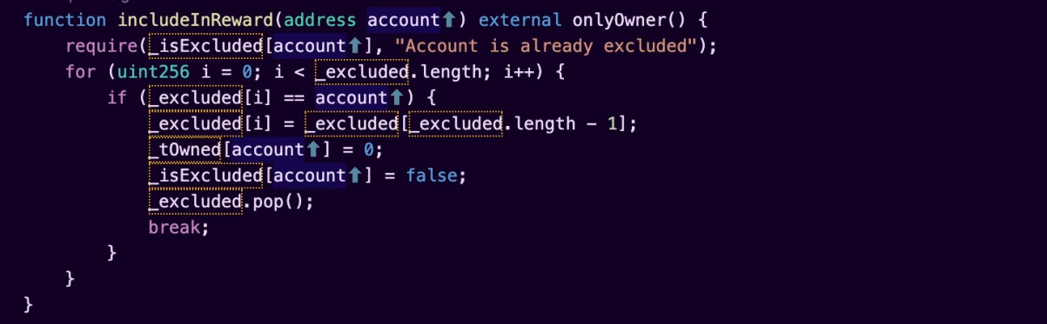
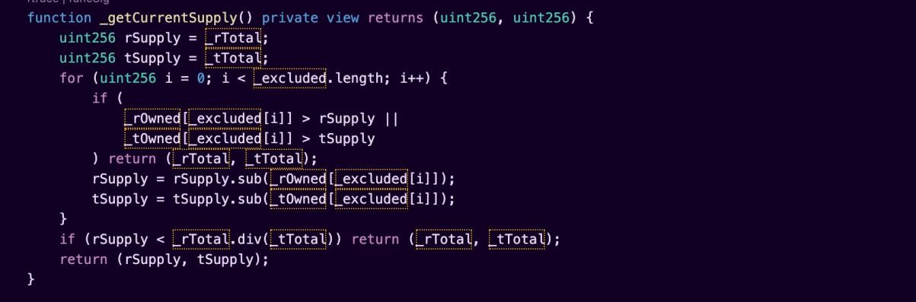
Security Issues
High Severity Issues
No high severity issues found.
Medium Severity Issues
No medium severity issues found.
Low Severity Issues
1. Out of gas
Issue:
The function
includeInReward()
uses the loop to find and remove
addresses from the list. Function will be aborted with
_excluded
OUT_OF_GAS exception if there will be a long excluded addresses list.
The function _getCurrentSupply also uses the loop for evaluating total supply. It also could be aborted with OUT_OF_GAS exception if there will be a long excluded addresses list.
Recommendation:
Check that the excluded array length is not too big.

Slide 14
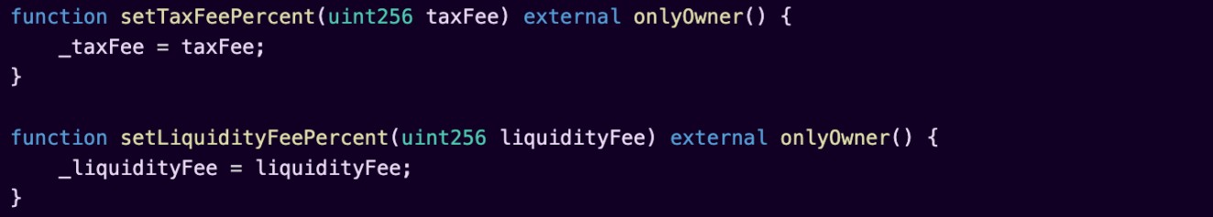
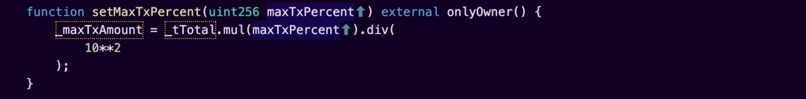
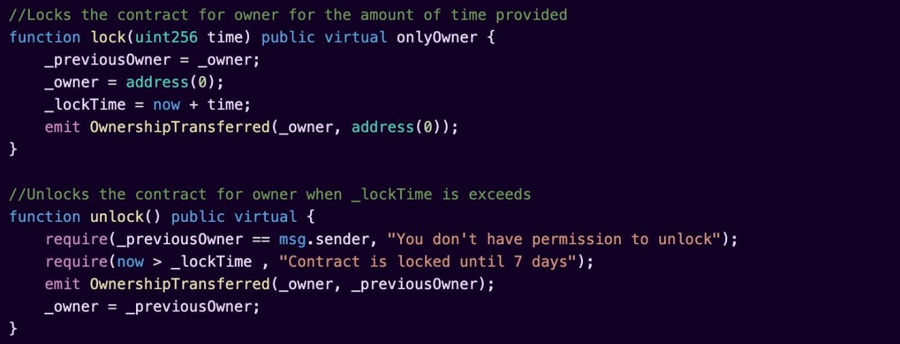
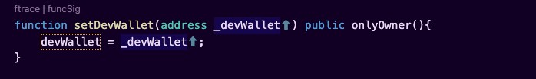
Owner privileges (In the period when the owner is not renounced)
Owner can change the tax and liquidity fee.
Owner can change the maximum transaction amount.
Owner can exclude from the fee.
Owner can lock and unlock. By the way, using these functions the owner could retake privileges even after the ownership was renounced.
Owner can change dev wallet address.
Owner can change number of tokens to add to liquidity.

Slide 15
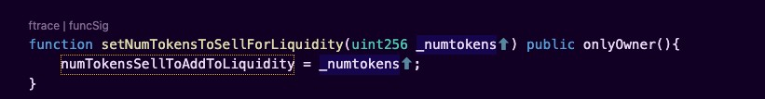
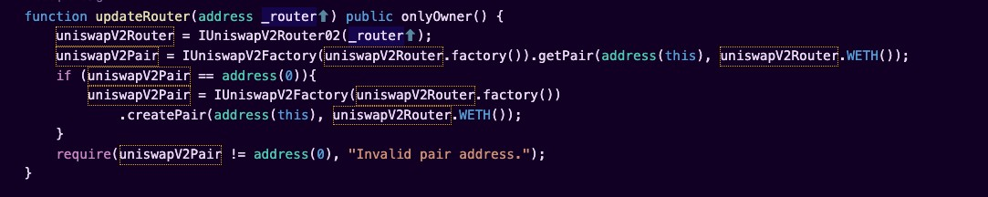

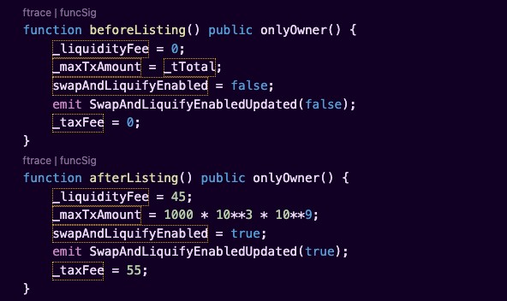
Owner can change Uniswap router.
Owner can change amount of _notReflectionFraction.
Owner can enable trading.
Owner can enable before and after listing settings preset.

Slide 16




Conclusion
Smart contracts contain low severity issues! Liquidity pair contract’s
security is not checked due to out of scope.
Liquidity locking details provided by the team: https://dxsale.app/app/pages/defipresale?saleID=2929&chain=TRX
TechRate note:
Please check the disclaimer above and note, the audit makes no statements or warranties on business model, investment attractiveness or code sustainability. The report is provided for the only contract mentioned in the report and does not include any other potential contracts deployed by Owner.

